Slide 1
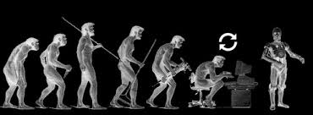


Machine Learning – 3
Swakkhar Shatabda
Department of CSE, UIU

Slide 2

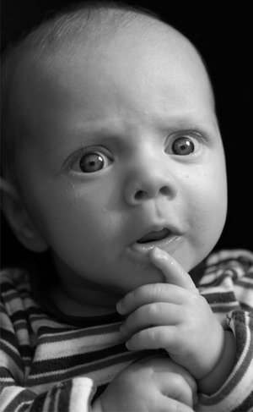
Outline
Introduction To KERAS
Activation Functions
Bias vs Variance
Regularization
Deep vs Wide Networks

Slide 3
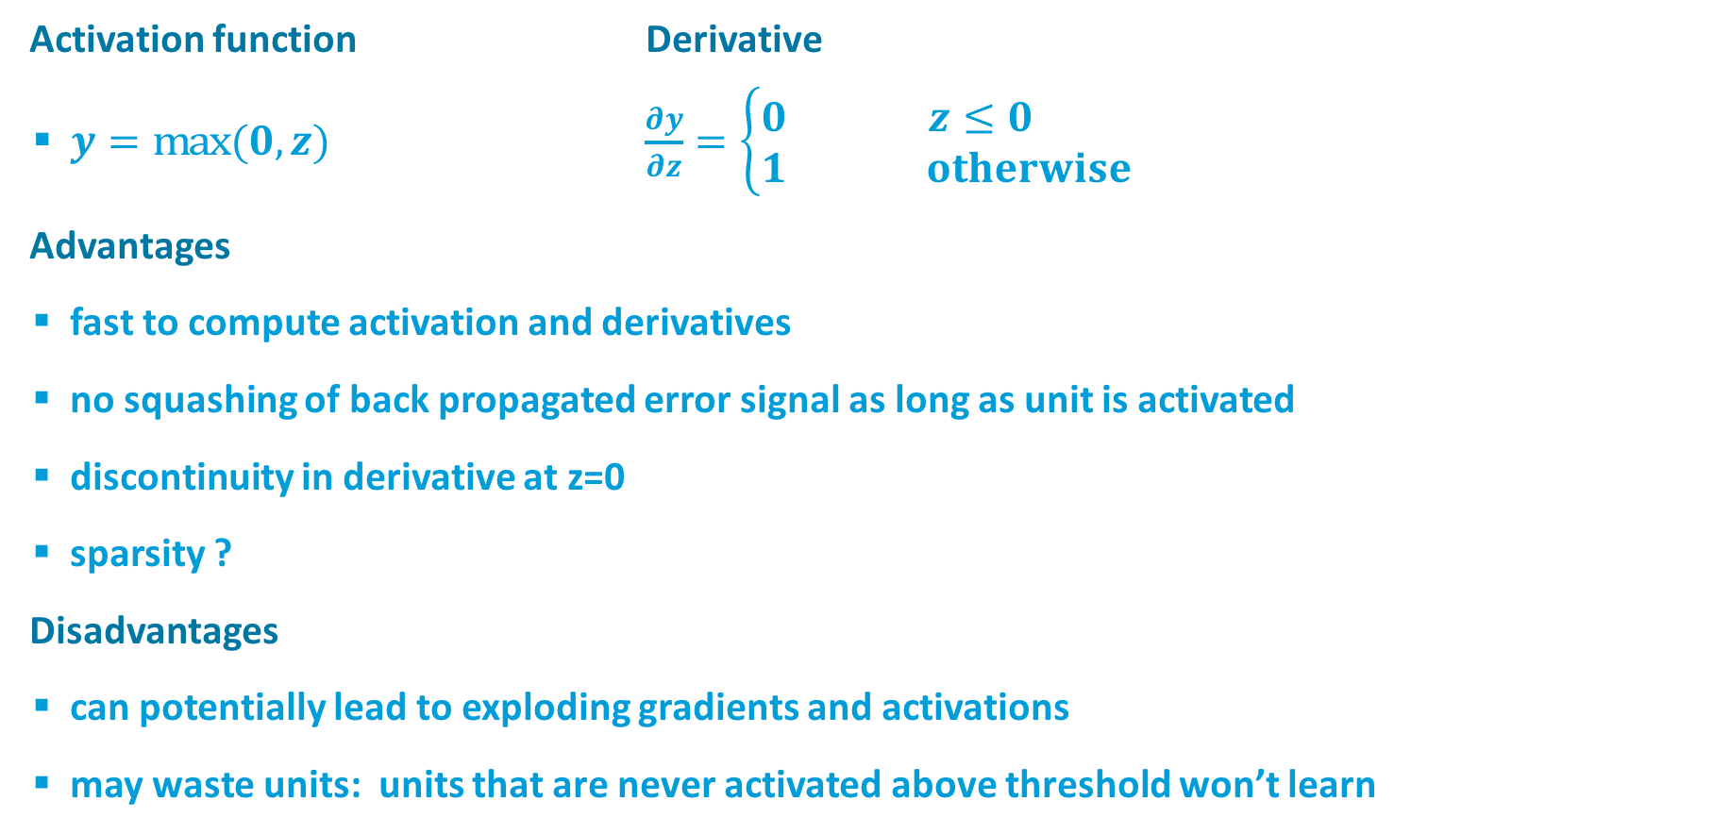


Rectified Linear Unit (ReLU)
$$y$$
$$z$$
Activation function Derivative
$y=\text{max}(0,z)$ $\frac{∂y}{∂z}=\left\{\begin{matrix}0 & z≤0 \\ 1 & otherwise\end{matrix}\right.$
Advantages
fast to compute activation and derivatives
no squashing of back propagated error signal as long as unit is activated
discontinuity in derivative at z=0
sparsity ?
Disadvantages
can potentially lead to exploding gradients and activations
may waste units: units that are never activated above threshold won’t learn

Slide 4
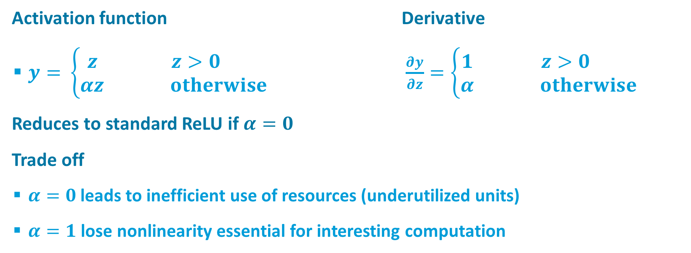
Leaky ReLU
$$y$$
$$z$$
Activation function Derivative
$y=$ $\left\{\begin{matrix}z & z>0 \\ αz & otherwise\end{matrix}\right.$ $\frac{∂y}{∂z}=\left\{\begin{matrix}1 & z>0 \\ α & otherwise\end{matrix}\right.$
Reduces to standard ReLU if $α=0$
Trade off
$α=0$leads to inefficient use of resources (underutilized units)
$α=1$ lose nonlinearity essential for interesting computation

Slide 5
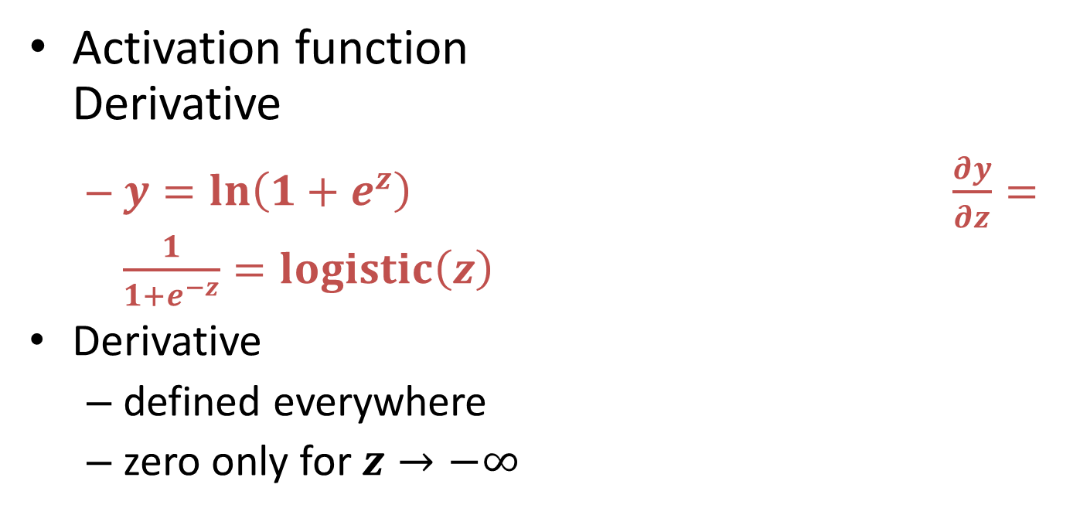
Softplus
$$y$$
$$z$$
Activation function Derivative
$y=ln\left(1+e^{z}\right) \frac{∂y}{∂z}=\frac{1}{1+e^{−z}}=logistic\left(z\right)$
Derivative
defined everywhere
zero only for $z→−∞$

Slide 6
Bias vs Variance
Suppose, you have done a survey to know who will win in Mayor Election Dhaka North in your class room. Now can you predict the outcome based on this survey?
That depends on the bias and the variance
Bias
Difference between predicted and actual value
Variance
Estimate of the target function will change if different training data was used.

Slide 7
Bias vs Variance
Low Bias
- mostly depends on the training data
- Not much assumption about the model
- KNN, SVM, Decision Tree
High Bias
- assumption about the model
- underfitting
- not adequate data
- Linear and logistic regression
Low Variance
- changes to the training dataset makes small changes on the model
- Linear and logistic regression
High Variance
- mostly depends on the training data
- captures noise
- overfits
- KNN, SVM, Decision Tree

Slide 8
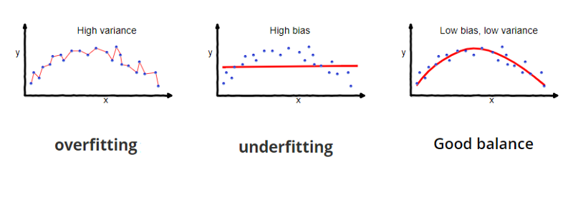
Bias vs Variance

Slide 9
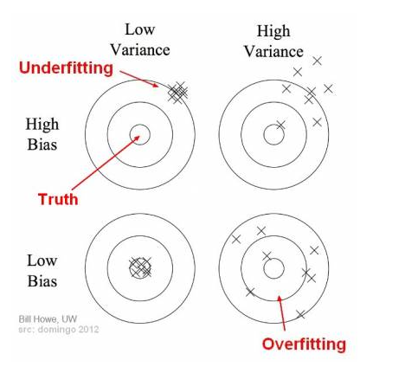
Bias vs Variance

Slide 10
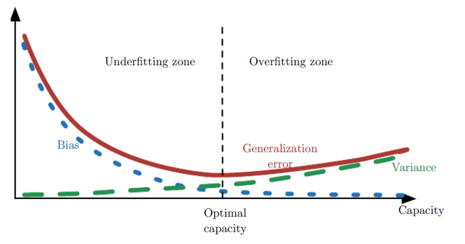
Bias vs Variance
Consider a case of KNN/linear Regression, how to do trade-off?

Slide 11
Output UnitS
SoftmaX
multinoulli
Linear
Regression
Sigmoid
Bernoulli

Slide 12
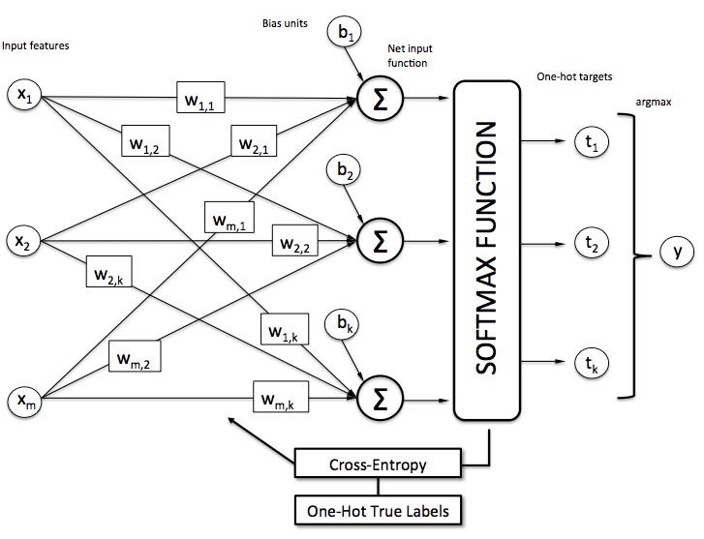
SoftmaX

Slide 13
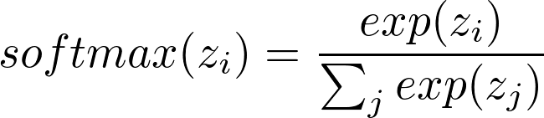

SoftmaX
Works well with log-likelihood
In that case it becomes
The first term never saturates
The second term tries to maximize z_{j}
When used with squared error,

Slide 14
Regularization
Suppose we have one single feature x and y
Lets artificially generate y as sin(2πx) by adding some Gaussian noise to it.
Our task is to fit the data using a polynomial

Slide 15
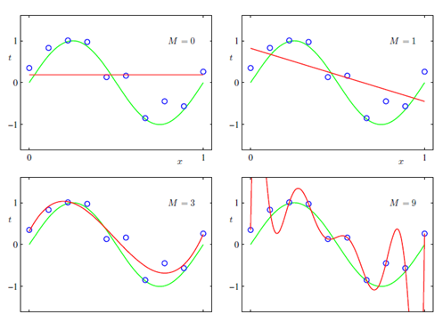
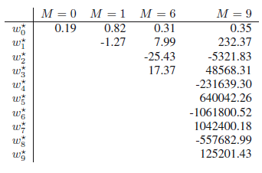
Regularization

Slide 16
Regularization
Larger size of data might help
Models tend to be more complex on them
However, its unwise to select parameters
of the model based on training data size

Slide 17

Regularization

Slide 18
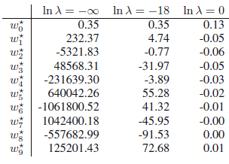
Regularization

Slide 19
Regularization - NN

Slide 20
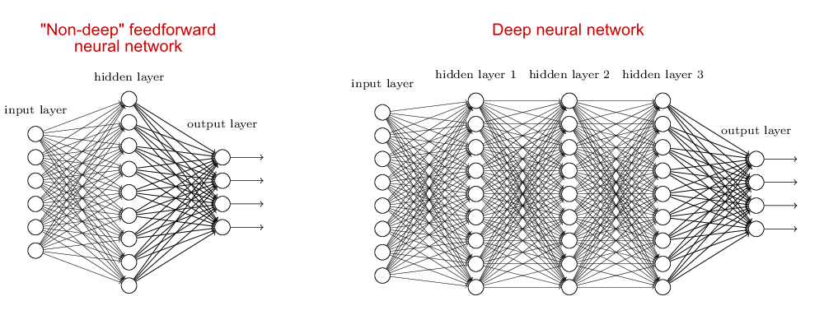
Wide vs Deep
Consider calculating parity of n bits

Slide 21
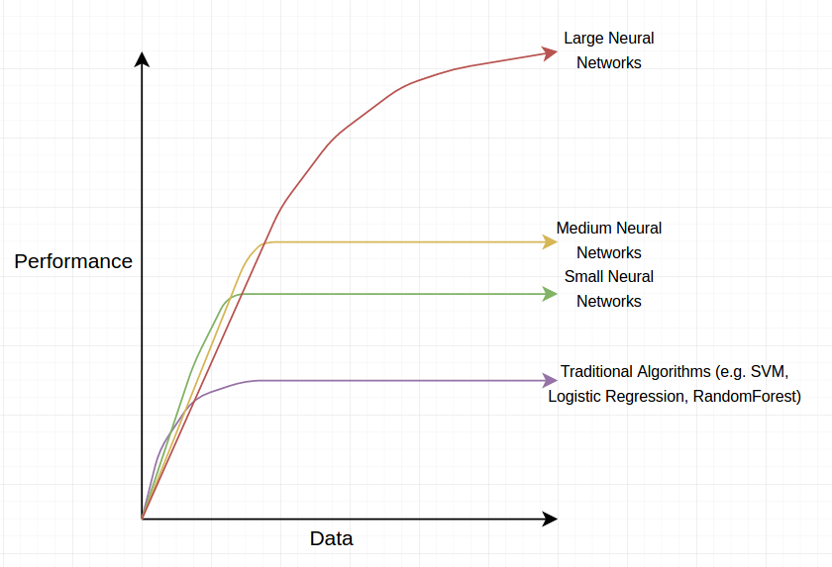
Deep Neural Nets

Slide 22
Batch vs MiniBatch
Larger batches provide a more accurate estimate of the gradient, but with less than linear returns.
Multicore architectures are usually underutilized by extremely small batches. This motivates using some absolute minimum batch size, below which there is no reduction in the time to process a minibatch.
If all examples in the batch are to be processed in parallel, then the amount of memory scales with the batch size. For many hardware setups this is the limiting factor in batch size.
Some kinds of hardware achieve better runtime with specific sizes of arrays. Especially when using GPUs, it is common for power of 2 batch sizes to offer better runtime.
Small batches can offer a regularizing effect, perhaps due to the noise they add to the learning process. Generalization error is often best for a batch size of 1. Training with such a small batch size might require a small learning rate to maintain stability due to the high variance in the estimate of the gradient. The total runtime can be very high due to the need to make more steps, both because of the reduced learning rate and because it takes more steps to observe the entire training set.

Slide 23
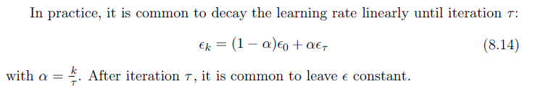
Stochastic Gradient Descent
SGD adds a source of noise that might escape local minima

Slide 24
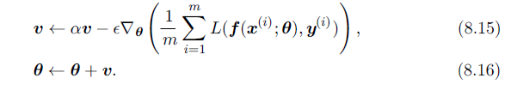
Momentum
The momentum algorithm accumulates an exponentially decaying moving average of past gradients and continues to move in their direction.

Slide 25
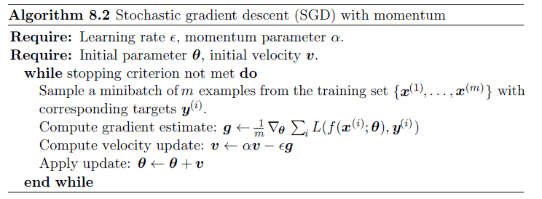
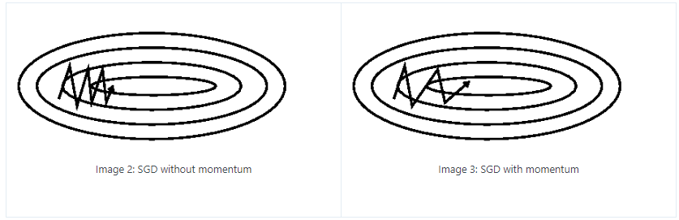
SGD with momentum

Slide 26
Adaptive learning rates
delta-bar-delta algorithm
if the partial derivative of the loss, with respect to a given model parameter, remains the same sign, then the learning rate should increase.
If the partial derivative with respect to that parameter changes sign, then the learning rate should decrease.
Of course, this kind of rule can only be applied to full batch optimization.

Slide 27
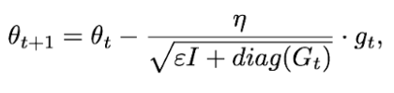
AdaGrad
Adagrad uses a different learning rate for every parameter at every time step
adapts the learning rates of all model parameters by scaling them inversely proportional to the square root of the sum of all of their historical squared values

Slide 28
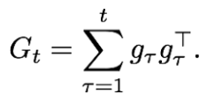
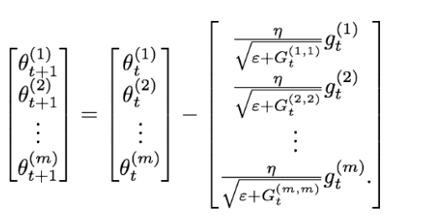
Adagrad

Slide 29
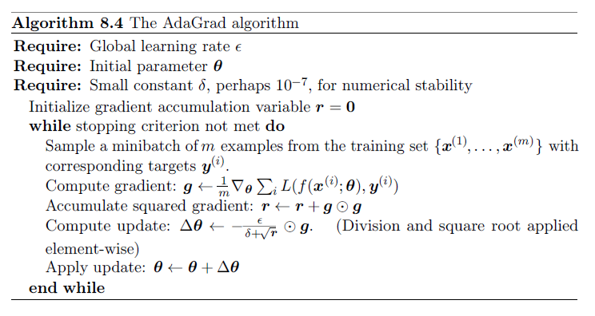
AdaGrad

Slide 30
RMSProp
Since every added term is positive, the accumulated sum keeps growing during training. This in turn causes the learning rate to shrink and eventually become infinitesimally small, at which point the algorithm is no longer able to acquire additional knowledge.
RMSProp modifies AdaGrad to perform better in the non-convex setting by changing the gradient accumulation into an exponentially weighted moving average

Slide 31
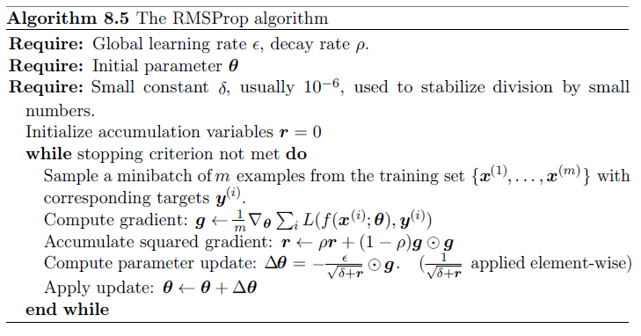
RmsProp

Slide 32
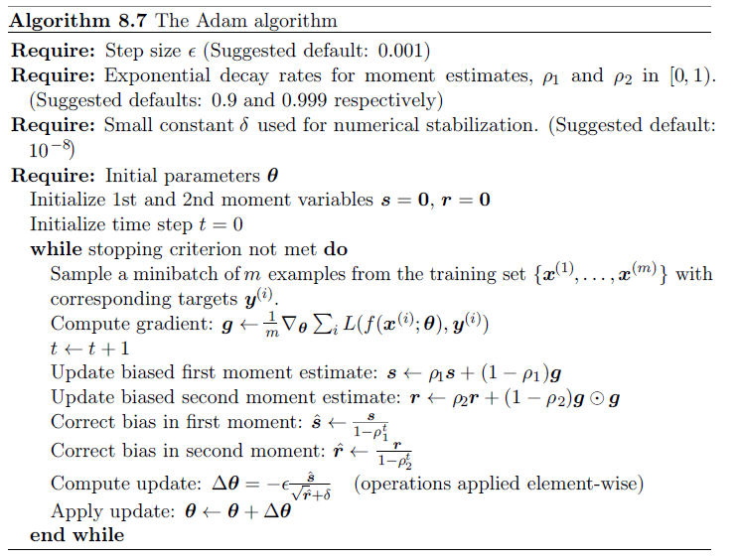
ADAM

Slide 33
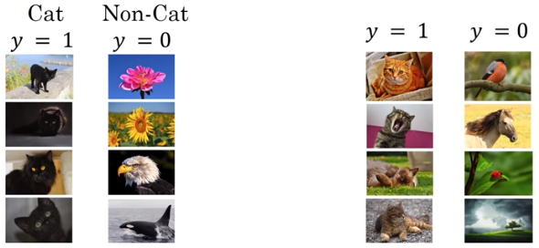
Batch Normalization
when we have features from 0 to 1 and some from 1 to 1000, we should normalize them to speed up learning.
If the input layer is benefiting from it, why not do the same thing also for the values in the hidden layers, that are changing all the time?

Slide 34
Early Stopping
When training large models with sufficient representational capacity to overfit the task, we often observe that training error decreases steadily over time, but validation set error begins to rise again.

Slide 35
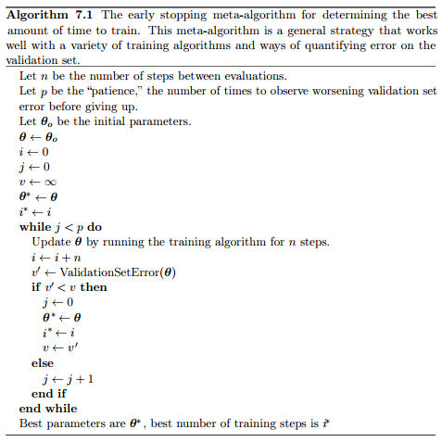
Early Stopping
Instead of running our optimization algorithm until we reach a (local) minimum of validation error, we run it until the error on the validation set has not improved for some amount of time.

Slide 36
Early Stopping
Retrain the weights/parameters
Start with the same set of parameters

Slide 37
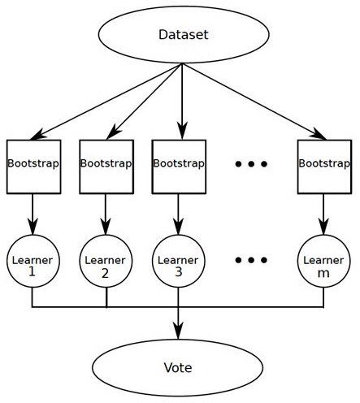
Bagging Ensemble

Slide 38
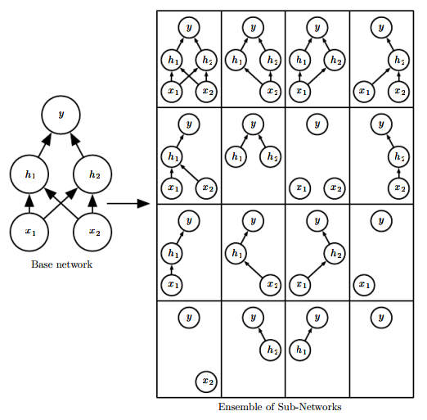
Dropout
Bagging with
Parameter Sharing

Slide 39
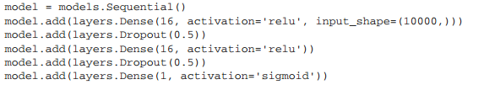
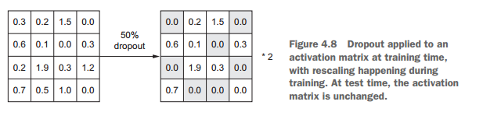
Dropout

Slide 40


